Slide 1

EuroGuiDerm Guideline for
Atopic Eczema
Overview of main recommendations

Slide 2
EuroGuiDerm Atopic Eczema Group
Denmark
France
Germany
Greece
Hungary
Italy
Netherlands
Norway
Poland
Spain
Switzerland
United Kingdom

Slide 3
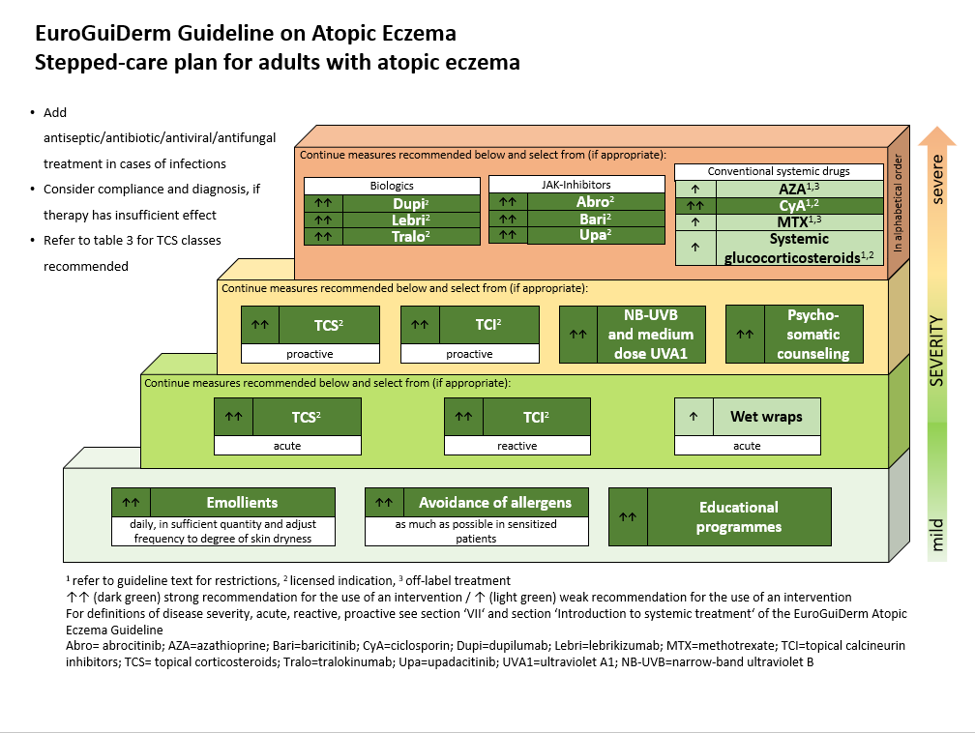
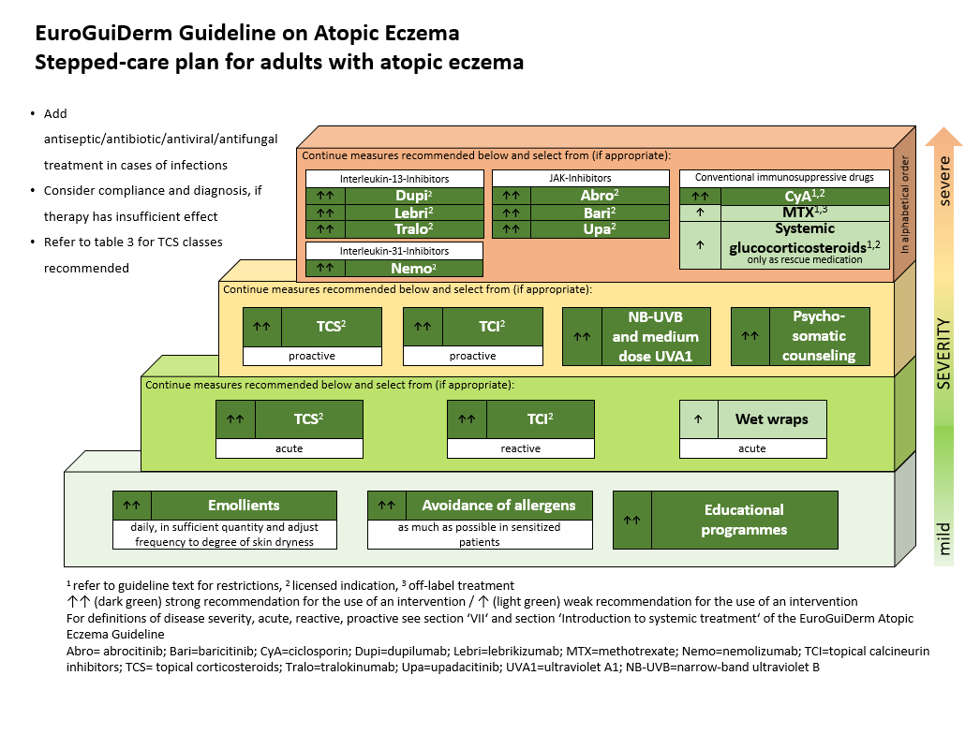

Slide 4

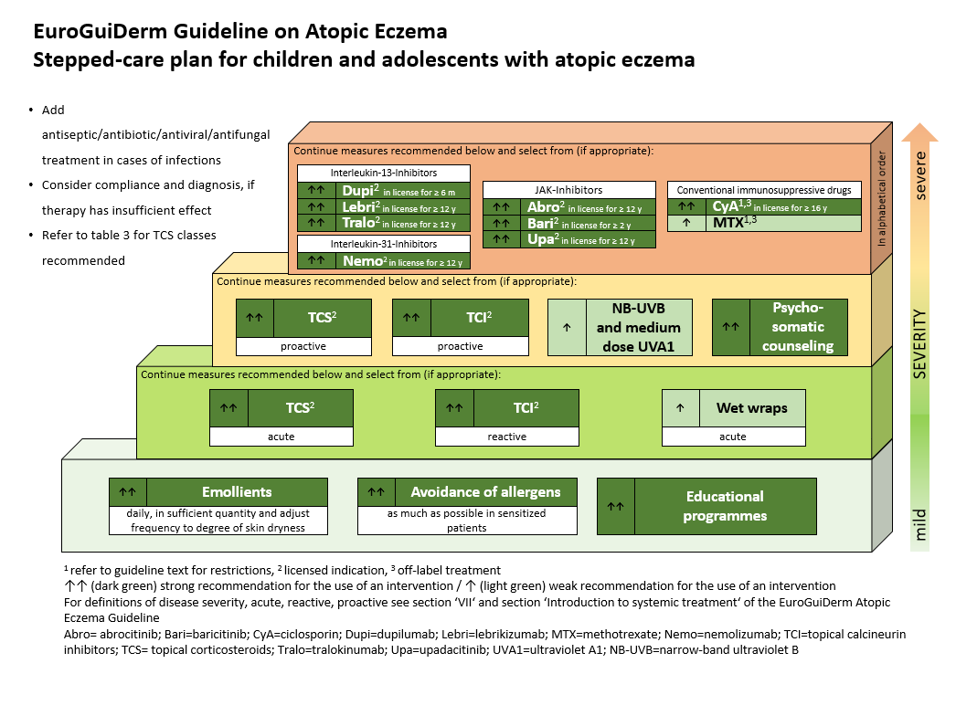

Slide 5
Wording of recommendations
Strength | Wording | Symbols | Implications
Strong recommendation for the use of an intervention | ‘We recommend . . .’ | ↑↑ | We believe that all or almost all informed people would make that choice. Clinicians will have to spend less time on the process of decision-making, and may devote that time to overcome barriers to implementation and adherence. In most clinical situations, the recommendation may be adopted as a policy.
Weak recommendation for the use of an intervention | ‘We suggest . . .’ | ↑ | We believe that most informed people would make that choice, but a substantial number would not. Clinicians and health care providers will need to devote more time on the process of shared decision-making. Policy makers will have to involve many stakeholders and policy making requires substantial debate.
No recommendation with respect to an intervention | ‘We cannot make a recommendation with respect to . . .’ | 0 | At the moment, a recommendation in favour or against an intervention cannot be made due to certain reasons (e.g. no reliable evidence data available, conflicting outcomes, etc.)
Weak recommendation against the use of an intervention | ‘We suggest against . . .’ | ↓ | We believe that most informed people would make a choice against that intervention, but a substantial number would not.
Strong recommendation against the use of an intervention | ‘We recommend against . . .’ | ↓↓ | We believe that all or almost all informed people would make a choice against that intervention. This recommendation can be adopted as a policy in most clinical situations.

Slide 6
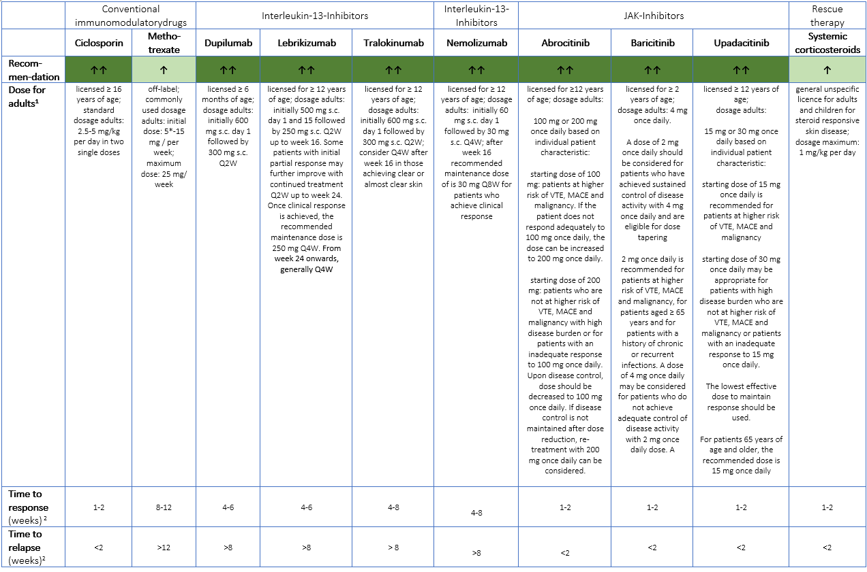

Slide 7
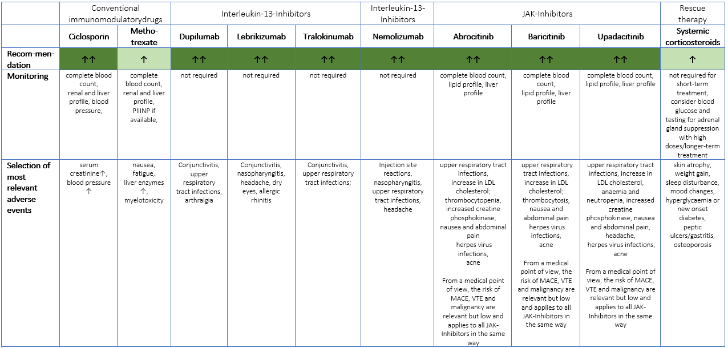

Slide 8
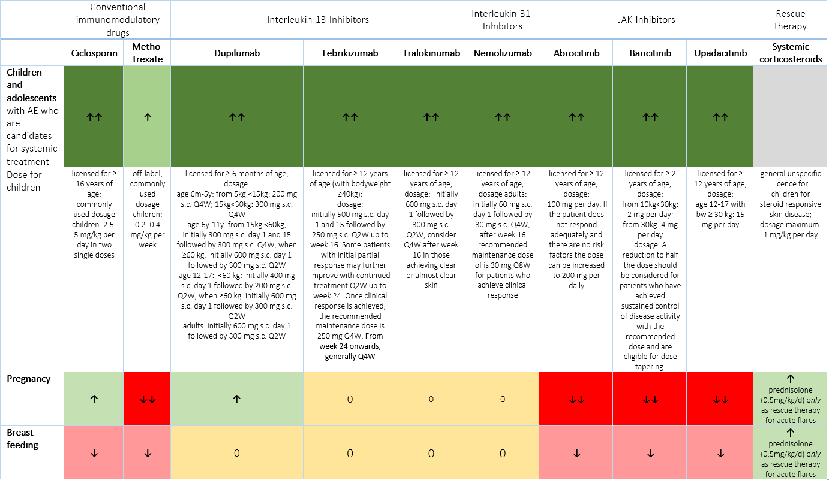

Slide 9
Overall recommendation | TCS ↑↑ |  | TCI ↑↑
 | TCS class I and II | TCS class III and IV | Tacrolimus 0.1% Tacrolimus 0.03% | Pimecrolimus 1%
For further information see background text | class I not suitable for long-term proactive treatment; long-term proactive treatment only class II | acute flare; proactive treatment with TCS class III class IV not for long term daily treatment or head and neck; class IV not recommended for proactive treatment either | acute flare; long-term proactive treatment; especially in face, intertriginous sites, anogenital area | acute flare; especially in face, intertriginous sites, anogenital area
Most important side effects | skin atrophy telangiectasia striae distensae ecchymosis hypertrichosis perioral dermatitis | skin atrophy telangiectasia striae distensae ecchymosis hypertrichosis perioral dermatitis corticosteroid addiction syndrome suppression of adrenal function | initial warmth, tingling or burning | initial warmth, tingling or burning
 | TCI class II and III are off label for proactive treatment |  | in label for proactive treatment | not suitable for proactive treatment
Special considerations
Suitable for children > 2 to < 16 years of age | yes | yes | yes (0.03%)² | yes²
Suitable for babies < 2 years of age | yes | under specialist supervision | yes (0.03%)¹ | yes² (from the age of three months)
Suitable during pregnancy | yes | yes | yes (0.03% & 0.1%)¹ | yes¹
Suitable during breastfeeding | yes | yes | yes (0.03% & 0.1%)¹ | yes¹
Suitable for pruritus | yes | yes | yes (0.03% & 0.1%) | yes
¹ off label use ² licensed use

Slide 10
Definitions and treatment goals

Slide 11

Patient’s perspective
We recommend that health care providers treat each patient as a whole person, not just the skin, while considering the burden of skin disease on life. | ↑↑ | 100% Patient/caregiver consensus
We recommend that health care providers are given time, training and resources to educate patients/caregivers in lay language about treating and managing their own condition. | ↑↑ | 100% Patient/caregiver consensus
We recommend that health care providers use the principle of shared decision-making, i.e. discuss the patients’ beliefs, lifestyle and preferences when deciding on a treatment plan. | ↑↑ | 100% Patient/caregiver consensus
We recommend that patients/caregivers receive adequate knowledge, skills, resources and support to treat their AE at home and cope with its impact on life. | ↑↑ | 100% Patient/caregiver consensus
We recommend that patients with co-morbidities are treated by multi-disciplinary teams. | ↑↑ | 100% Patient/caregiver consensus
We recommend that patients have access to all available treatments and that these treatments are affordable and practical. | ↑↑ | 100% Patient/caregiver consensus

Slide 12

Basic emollients and moisturizers
We recommend daily use of emollients, liberally and frequently for patients with AE, as basic treatment of the disturbed skin barrier function. | ↑↑ | >75% (20/23) Expert Consensus
We recommend gentle cleansing and bathing procedures especially in acutely inflamed or superinfected skin in patients with AE. | ↑↑ | 100% (18/18) Expert Consensus
We suggest using moisturizers with a hydrophilic formula in the summer and moisturizers with a higher lipid content in the winter in patients with AE. | ↑ | >75% (15/18)¹ Expert Consensus
¹1 Abstention
We recommend to apply emollients immediately after bathing or showering and soft pat drying (“soak and seal technique”). | ↑↑ | 100% (19/19) Expert Consensus
We suggest bathing in moderately warm water over a short duration of time in patients with AE. | ↑ | >75% (17/19) Expert Consensus
We suggest against the use of alkaline soaps in patients with AE. | ↓ | 100% (19/19) Expert Consensus
We suggest that patients with AE use body care products, for example gentle cleansers that do not contain potent irritants or relevant allergens. | ↑
We recommend the use of emollients as background treatment to prevent flares and to reduce the symptoms of AE. | ↑↑ | >75% (18/19)¹ Expert Consensus
¹1 Abstention

Slide 13

Antiinflammatory treatment
We recommend TCS in AE especially for treatment of acute flares. | ↑↑ | 100% (23/23) Expert Consensus
We recommend to note and adequately address patients concerns or fears about corticosteroid side effects.
We recommend using TCI particularly in skin areas with a risk of skin atrophy due to TCS application (face, intertriginous sites, anogenital area).
We recommend the use of topical corticosteroids (TCS) as anti-inflammatory agents. | ↑↑ | >75% (24/26) Expert Consensus
We recommend the use of topical calcineurin inhibitors (TCI) as anti-inflammatory agents.
We suggest using anti-inflammatory topical agents according to the fingertip unit rule. | ↑ | >75% (23/26) Expert Consensus
We suggest initial treatment with topical corticosteroids before switching to a TCI to reduce the risk of skin stinging and burning. | ↑ | 100% (23/23) Expert Consensus
We suggest the use of wet wraps with diluted (see background text) or low potency topical corticosteroid in acute AE. | ↑ | >50% (14/22) Expert Consensus
We recommend proactive therapy (e.g. twice weekly application) with a suitable TCS or a suitable TCI (see background text) to reduce the risk of relapse and for better disease control. | ↑↑ | 100% (22/22) Expert Consensus

Slide 14
Overall recommendation | TCS ↑↑ |  | TCI ↑↑
 | TCS class I and II | TCS class III and IV | Tacrolimus 0.1% Tacrolimus 0.03% | Pimecrolimus 1%
For further information see background text | class I not suitable for long-term proactive treatment; long-term proactive treatment only class II | acute flare; proactive treatment with TCS class III class IV not for long term daily treatment or head and neck; class IV not recommended for proactive treatment either | acute flare; long-term proactive treatment; especially in face, intertriginous sites, anogenital area | acute flare; especially in face, intertriginous sites, anogenital area
Most important side effects | skin atrophy telangiectasia striae distensae ecchymosis hypertrichosis perioral dermatitis | skin atrophy telangiectasia striae distensae ecchymosis hypertrichosis perioral dermatitis corticosteroid addiction syndrome suppression of adrenal function | initial warmth, tingling or burning | initial warmth, tingling or burning
 | TCI class II and III are off label for proactive treatment |  | in label for proactive treatment | not suitable for proactive treatment
Special considerations
Suitable for children > 2 to < 16 years of age | yes | yes | yes (0.03%)² | yes²
Suitable for babies < 2 years of age | yes | under specialist supervision | yes (0.03%)¹ | yes² (from the age of three months)
Suitable during pregnancy | yes | yes | yes (0.03% & 0.1%)¹ | yes¹
Suitable during breastfeeding | yes | yes | yes (0.03% & 0.1%)¹ | yes¹
Suitable for pruritus | yes | yes | yes (0.03% & 0.1%) | yes
¹ off label use ² licensed use

Slide 15

Antimicrobial treatment
We suggest treatment with topical antiseptic drugs – including sodium hypochlorite 0.005% baths -in patients with a history of recurrent skin infections. | ↑ | 100% (24/24) Expert Consensus
We recommend to treat eczema herpeticum without delay using systemic antiviral therapy, such as aciclovir. | ↑↑ | 100% (25/25) Expert Consensus
We recommend to perform vaccinations in line with national guidelines. | ↑↑
We recommend a short course of systemic antibiotics only in AE patients with extensive clinically superinfected lesions. | ↑↑ | 100% (25/25) Expert Consensus
We suggest against the long-term application of topical antibiotics, due to the risk of resistance development . | ↓
We suggest that topical anti-inflammatory treatments are continued during the treatment of Staphylococcus aureus superinfection episodes. | ↑
We suggest topical or systemic antifungal therapy in some patients with AE, mainly in those suffering from the „head and neck“ variant of AE. and with demonstrated IgE-sensitization to Malassezia spp. | ↑ | >95% (23/24) Expert Consensus

Slide 16
Anti-pruritic treatment
We suggest against using first generation systemic antihistamines as a long term treatment for itch in AE. | ↓ | 100% (22/22) Expert Consensus
We cannot make a recommendation on the use of polidocanol in itch treatment in AE. | 0 | >75% (16/17) Expert Consensus
We recommend against topical antihistamines in itch treatment in AE. | ↓↓ | >75% (17/18)¹ Expert Consensus
¹ 1 Abstention
We suggest against using second generation systemic antihistamines as a treatment for itch in AE. | ↓ | >75% (13/15)¹ Expert Consensus
¹ 1 Abstention
We suggest UV therapy (both narrowband UVB and UVA1) for the treatment of itch in AE. Also see phototherapy chapter | ↑ | >75% (17/19)¹ Expert Consensus
¹2 Abstention
We suggest against the use of selective serotonin reuptake inhibitors as itch treatment in AE patients. | ↓ | 100% (20/20) Expert Consensus

Slide 17
Phototherapy and Photochemotherapy
We suggest that PUVA therapy is only used, when previous treatment cycles with other phototherapies were ineffective or when approved drug treatments are contraindicated, ineffective or have caused side effects. | ↑ | 100% (25/25) Expert Consensus
We recommend narrowband UVB and medium-dose UVA1 for AE patients with moderate-to-severe AE. | ↑↑ | >95% (24/25) Expert Consensus
We suggest co-treatment with topical emollients during phototherapy. | ↑ | 100% (25/25) Expert Consensus
We suggest the use of narrowband UVB or UVA1 in children and adolescents after the assessment of skin type (see background text), but frequent and/or protracted treatment cycles should be avoided. | ↑ | >95% (24/25)¹ Expert Consensus
¹ 1 abstention
We suggest that other phototherapy modalities (balneophototherapy, UVAB, BB-UVB, UVA) are to be considered as a second choice. | ↑ | 100% (25/25) Expert Consensus
We recommend against the use of prolonged or repeated treatment cycles and maintenance regimens with all phototherapy modalities. | ↓↓ | 100% (24/24) Expert Consensus
We recommend against the use of all phototherapy modalities in patients with a history of skin cancer and with an increased risk of skin cancer (including photodamaged skin and those on systemic immunosuppressants (see background text)). | ↓↓ | 100% (25/25) Expert Consensus

Slide 18
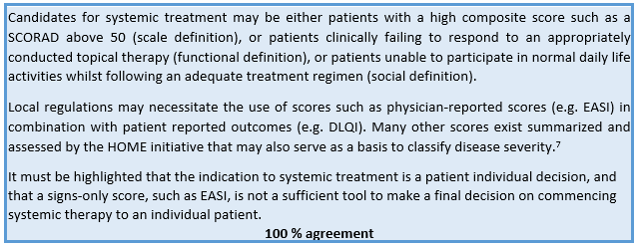
Patients who are candidates for systemic treatment

Slide 19
Detailed advise on management for each drug
Mechanisms of action and efficacy Dosage: acute flare, short term, long term Adult: Children: Safety Monitoring Combination with other treatments | ↑↑ | 100% Evidence and consensus based see Evidence Report

Slide 20
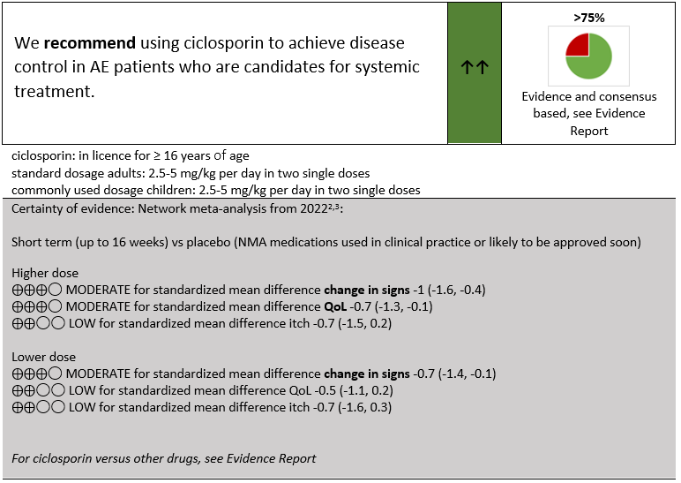
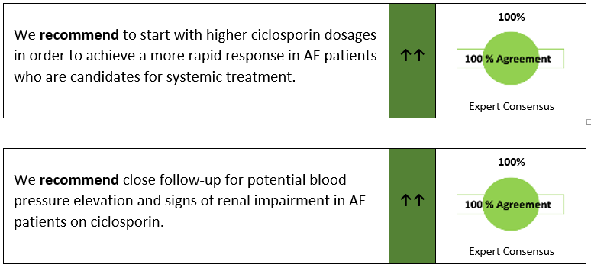
Conventional immunomodulatory drugs – Ciclosporin

Slide 21
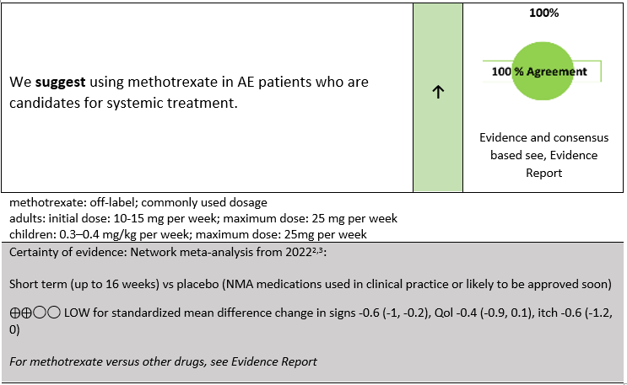
Conventional immunomodulatory drugs – Methotrexate

Slide 22
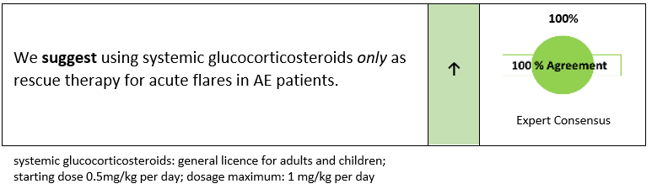
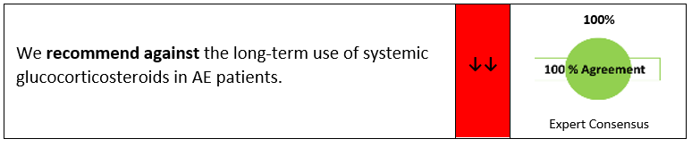
Conventional immunomodulatory drugs – Systemic glucocorticosteroids

Slide 23
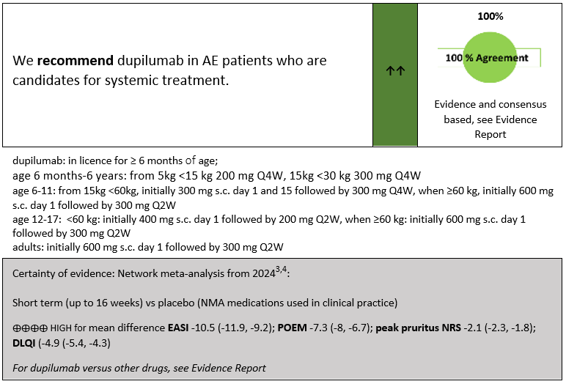
Interleukin-13-Inhibitors – Dupilumab

Slide 24
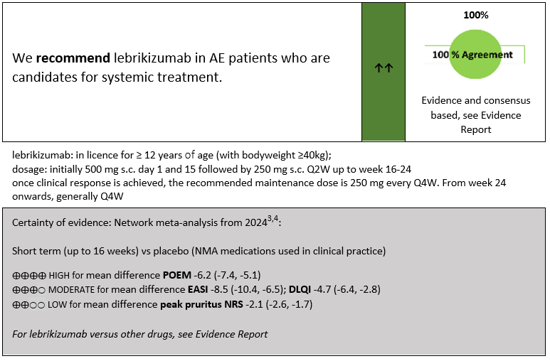
Interleukin-13-Inhibitors – Lebrikizumab

Slide 25
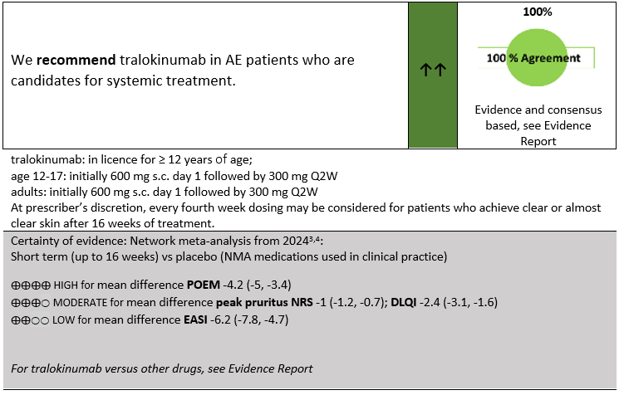
Interleukin-13-Inhibitors– Tralokinumab

Slide 26
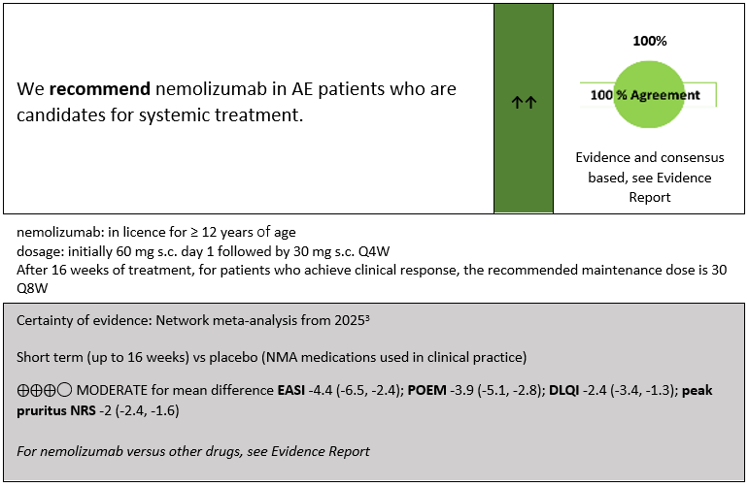
Interleukin-31-Inhibitors– Nemolizumab

Slide 27
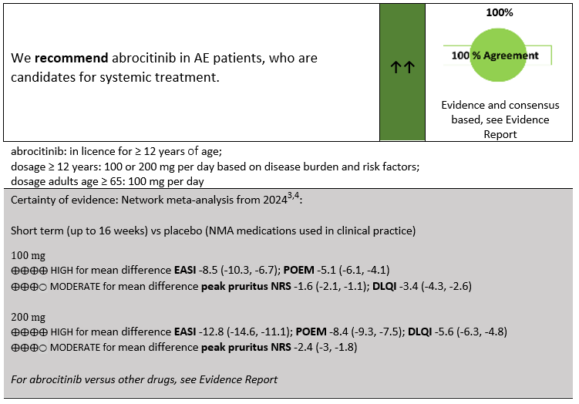
JAK-Inibitors – Abrocitinib

Slide 28
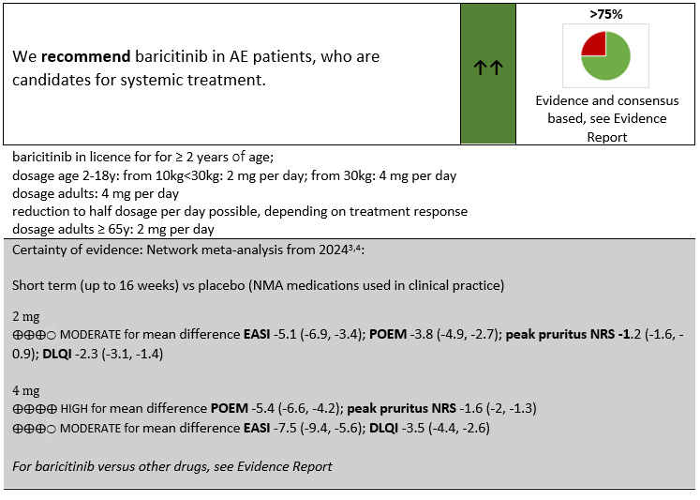
JAK-Inibitors – Baricitinib

Slide 29
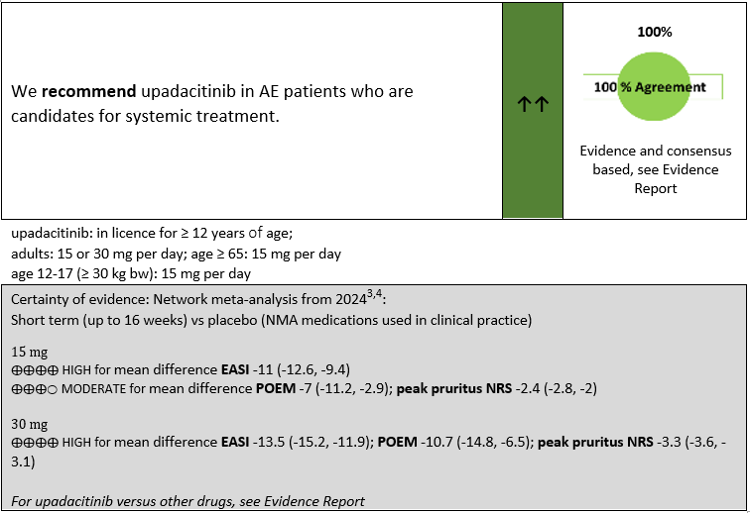
JAK-Inibitors – Upadacitinib

Slide 30
Avoidance techniques in atopic eczemama
We recommend to identify individual trigger factors in patients with AE, to avoid these in the future, with the aim of prolonging remission or clearance. | ↑↑ | >75% (16/17) Expert Consensus
We recommend avoiding irritant clothing (e.g. wool with coarse fibers) to prevent an exacerbation of AE in patients with sensitive skin. | ↑↑ | >75% (16/17) Expert Consensus
We recommend to avoid pollen, house dust mite and animal dander as much as possible to prevent exacerbation of AE in sensitized patients with a clear history of disease flares secondary to these triggers. | ↑↑ | >75% (14/15) Expert Consensus
We suggest that patients with AE learn strategies to cope with stress (e.g. educational programmes). In selected cases, counselling or psychotherapy is suggested. | ↑ | 100% (16/16) Expert Consensus
There is no need to restrict normal everyday physical activity in patients with AE. | Statement | >75% (17/19) Expert Consensus
We recommend the avoidance of tobacco smoke for the prevention of AE. | ↑↑ | >75% (17/18) Expert Consensus

Slide 31
Dietary interventions in atopic eczema I
IgE-mediated food allergy (immediate reactions): We recommend diagnostic procedures for the elucidation of IgE-mediated food allergy (food specific IgE and/or SPT, diagnostic elimination diets and challenge tests) in AE patients with a history of food-induced immediate symptoms. | ↑↑ | >75% (16/18)¹ Expert Consensus
IgE-mediated food allergy (immediate reactions) plus food-induced AE “delayed hypersensitivity”: We recommend diagnostic procedures for the elucidation of combined reactions to foods (immediate reactions plus food-induced eczema (food specific IgE and/or SPT, diagnostic elimination diets and challenge tests)) in AE patients with a history of food-induced symptoms, including worsening of AE. | ↑↑
History or suspicion of food-triggered AE “delayed hypersensitivity”: We suggest diagnostic procedures for the elucidation of food as a trigger factor of AE (food specific IgE and/or SPT, diagnostic elimination diets and challenge tests) in patients with moderate-to-severe AE and with a history or suspicion of food-triggered AE. | ↑
¹1 Abstention
We recommend to identify individual dietary trigger factors in patients with AE, to avoid these in the future, with the aim of prolonging remission or clearance. | ↑↑ | >75% (16/17) Expert Consensus

Slide 32
Dietary interventions in atopic eczema II
A therapeutic elimination diet is recommended after the individual diagnosis of food allergy or food–induced eczema in AE. | ↑↑ | 100% (17/17) Expert Consensus
We cannot make a recommendation on probiotics for the management of AE. | 0 | 100% (19/19) Expert Consensus
We recommend re-evaluation of a child’s IgE mediated food allergy after one to two years after strict elimination diet. | ↑↑ | 100% (17/17) Expert Consensus
We recommend against vitamins as a treatment for AE. | ↓↓ | 100% (17/17) Expert Consensus
We recommend against general dietary interventions (e.g. other supplements, general avoidance of certain foods e.g. cow´s milk, gluten) for the management of AE. | ↓↓ | 100% (19/19) Expert Consensus

Slide 33
Allergen-specific immunotherapy
We recommend against allergen-specific immunotherapy as a routine treatment option for AE. | ↓↓ | >50% (8/13) Expert Consensus
We suggest that AIT is considered for selected patients with aeroallergen sensitization and a history of clinical exacerbation after exposure to the causative allergen | ↑ | 100% (11/11) Expert Consensus

Slide 34
Complementary medicine
We recommend against acupuncture as standard therapy for AE. | ↓↓ | 100% (13/13) Expert Consensus
We recommend against Chinese herbal medicine as standard therapy for AE. | ↓↓ | 100% (12/12) Expert Consensus
We recommend against phytotherapy as standard therapy for AE. | ↓↓ | 100% (14/14) Expert Consensus
We cannot make a recommendation with respect to alpine climate therapy for AE. | 0 | >75% (11/12) Expert Consensus
We recommend against blood autologous serum as standard therapy for AE. | ↓↓ | 100% (12/12) Expert Consensus

Slide 35
Psychological and educational interventions
We suggest that therapeutic patient education programmes with proven efficacy in children and adults with AE are widely implemented. | ↑ | 100% (14/14) Expert Consensus

Slide 36
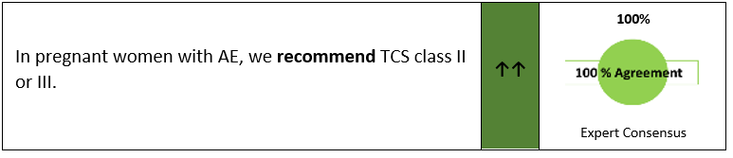
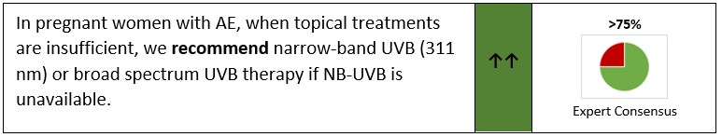
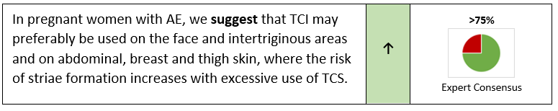
Pregnancy I

Slide 37
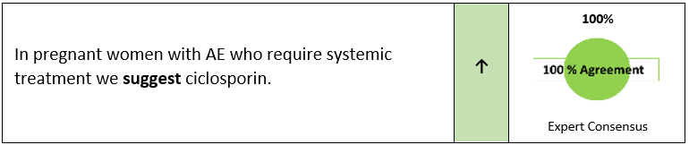
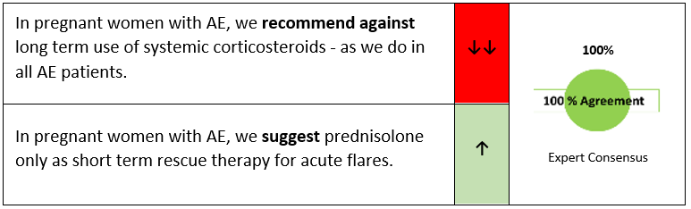
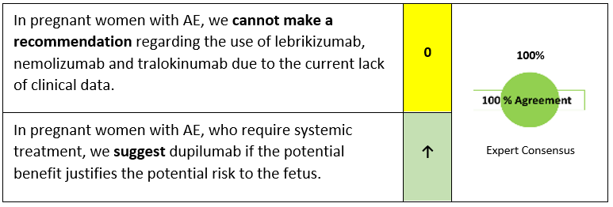
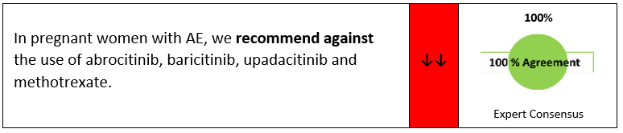
Pregnancy II

Slide 38
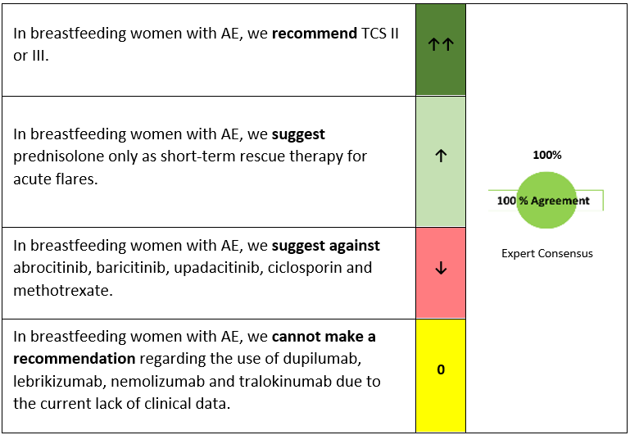
Breastfeeding women

Slide 39
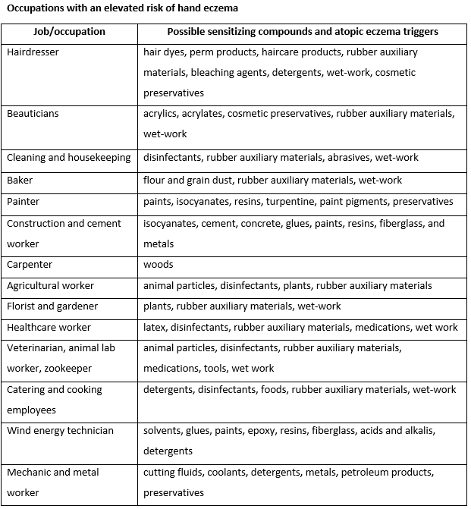
Occupational aspects
AE can have a negative impact on work life and is associated with a higher risk of hand eczema. | State-ment | 100% (15/15) Expert Consensus
We suggest individual pre-employment counselling regarding choice of profession, including risk assessment, avoidance strategies and protective measures. | ↑ | 100% (23/23) Expert Consensus

